Slide 1
Color sensor prototype using Artificial Neural Network
Done By:
Ayush Tripathi(2101EE90)
Under the guidance of:
Assosiate Prof. Saurabh Kumar Pandey
Electrical and Electronics Engineering
IIT Patna

Slide 2
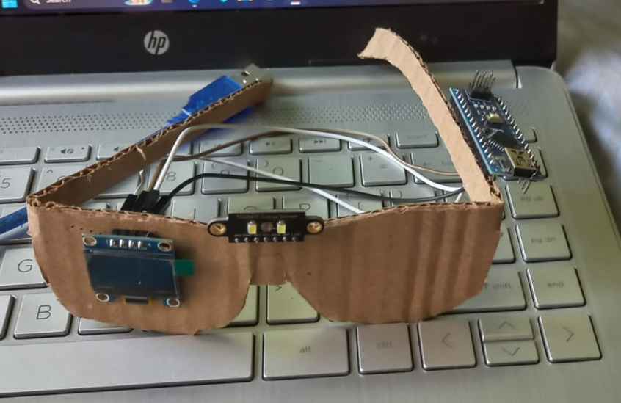
Abstract
This project aims to create a RGB colour sensor using TCS3472 colour sensor and Ardino Nano using MLP technique to expand the colour detection to different shades of Red, Green and Blue. This prototype is small is size thus easily mountable on any spectacles, making it convenient for colour blind individuals to detect colour.

Slide 3
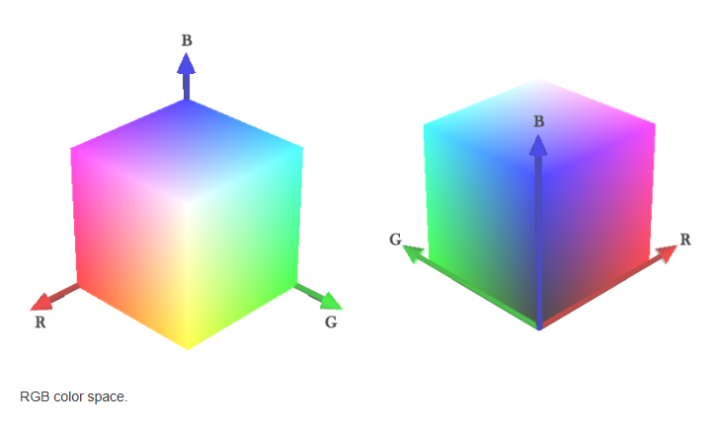
Project overview
Similar to colour vision of eye, the RGB model comprises more than 16 million colours, which are arrange in a 3D space, where integer values of components R(red), G(Green), B(Blue), ranging from 0 to 255, constitute coordinates of this space, From this model, colour detection and recognition were performed with light-related electronic components and Deep learning mechanisms.
Color recognition can be performed with Multilayer Perceptron(MLP) - an architecture of Artificial Neural Networks (ANN). It allows classification and recognition of spatially separable patterns - very useful in this case.
This is comparable to outliers or distorted patterns, which may affect precision in the recognizing task; regarding feature (RGB) space, a misclassified color should be interpreted as a coordinate located at spatial regions associated to another color (sometimes due to poor generalization, overfitting, and many other possibilities.)

Slide 4
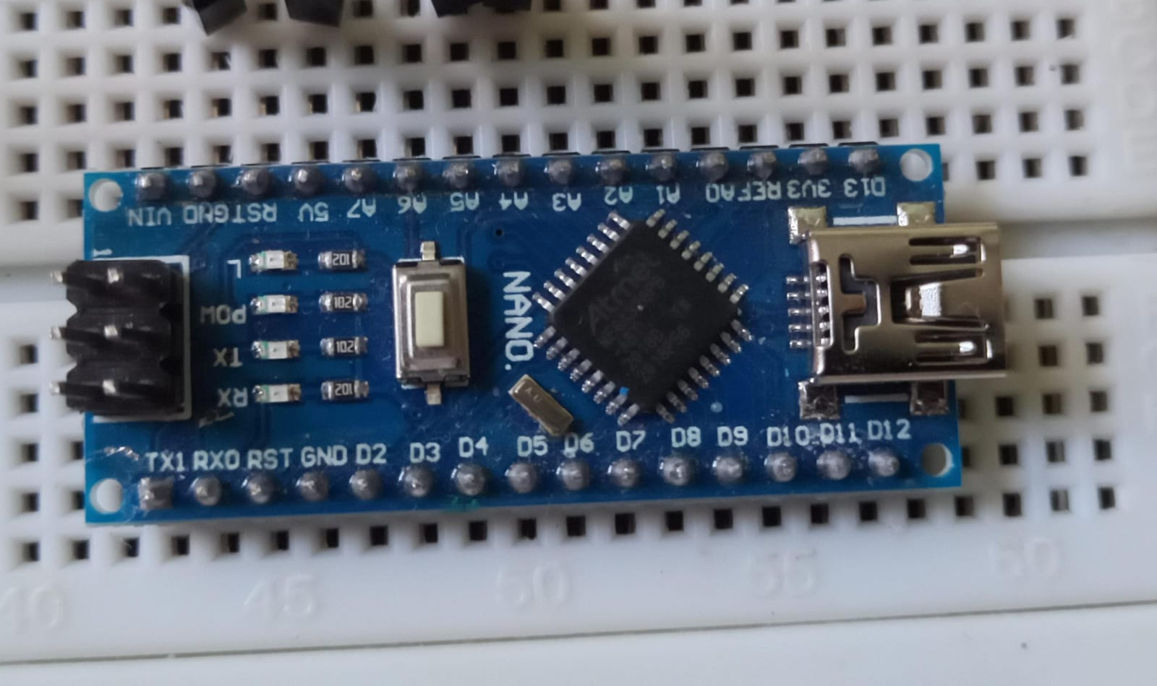
Hardware Overview
ARDINO NANO
a small, complete, and breadboard-friendly board based on the ATmega328 microcontroller. It offers the same connectivity and specs as the Arduino Uno but in a more compact form factor. The Nano lacks a DC power jack and uses a Mini-B USB cable for programming and power supply. With 32 KB of flash memory, 2 KB of SRAM, and 1 KB of EEPROM,

Slide 5
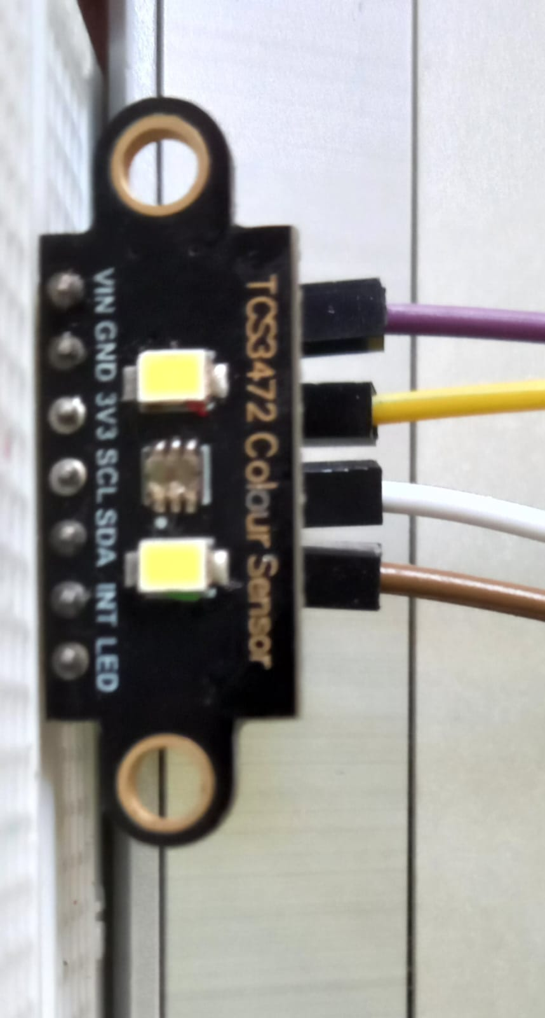
Hardware Overview
TCS3472 Colour Sensor
an I2C-based color sensor that detects red, green and blue values. It provides a digital return of RGB values. With its high sensitivity, wide dynamic range, and IR blocking filter, the TCS34725 is ideal for use under varying lighting conditions. I interfaced with an Arduino Nano, using the I2C protocol.

Slide 6
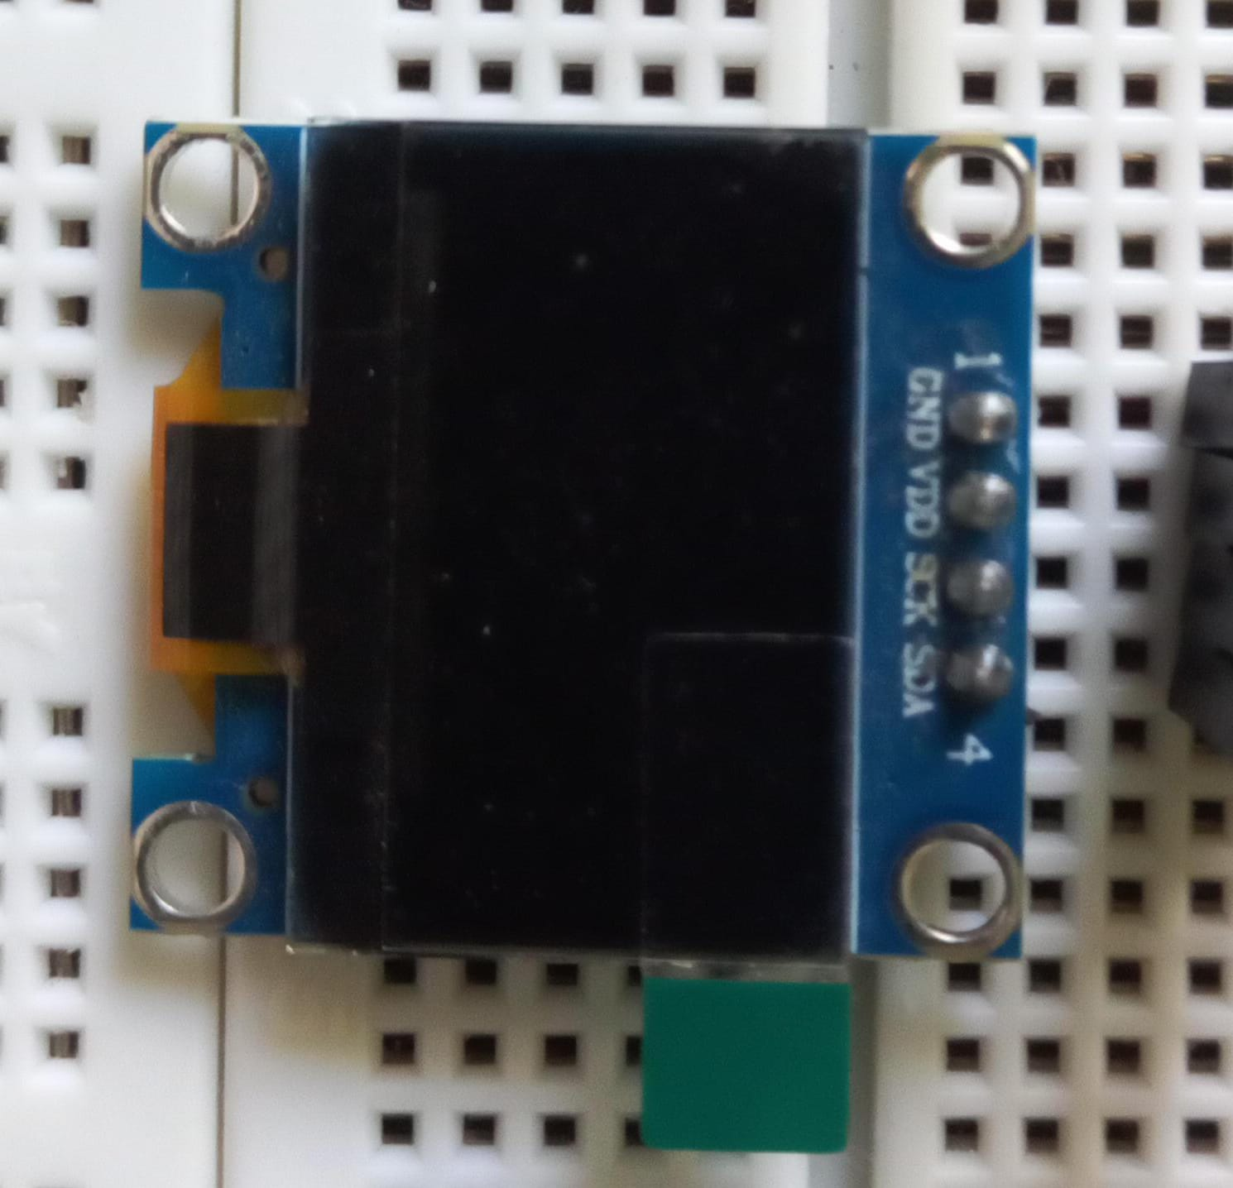
Hardware Overview
I2C OLED DISPLAY MODULE
features a 0.96-inch monochrome OLED screen based on the SSD1306 driver IC. With a resolution of 128x64 pixels, this display communicates via the I2C (Inter-Integrated Circuit) protocol, making wiring straightforward. Its compact form factor and low power consumption make it ideal. I have used the adafruit_SSD1306.h and
adafruit_GFX.h libraries to control the display, allowing me to write text, draw shapes, and even display bitmap images.

Slide 7
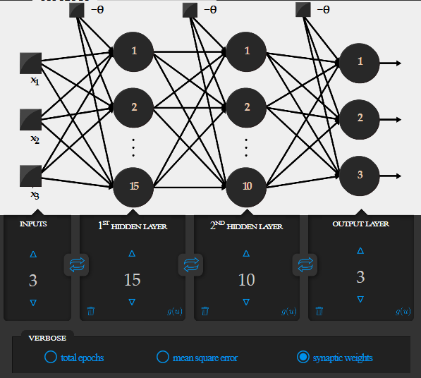
Multi-Layer Perceptron
Multi-Layer Perceptron is a feedforward architecture of ANNs, having an input (non-neural) layer, hidden layers and an output layer. This network is trained by backpropagation algorithm, performing supervised learning (learning by examples).
Topology configuration
For this color sensor, as indicated in the image, the neural network receives 3 inputs (RGB values), having two hidden layer with 15 and 10 neurons respectively and an output layer with 3 neurons since the output layer must have the same number of classes (colors, in this case), for a binarized output. Hidden-layer sizes are empirically obtained, establishing ranges of values for each topological parameter, so that approaches for
Hyperparameter optimization may find potentially good results (this can be a bit difficult and slow sometimes). The network below is already trained and interactive, so it is possible to input values at training tab and check the outputs.

Slide 8
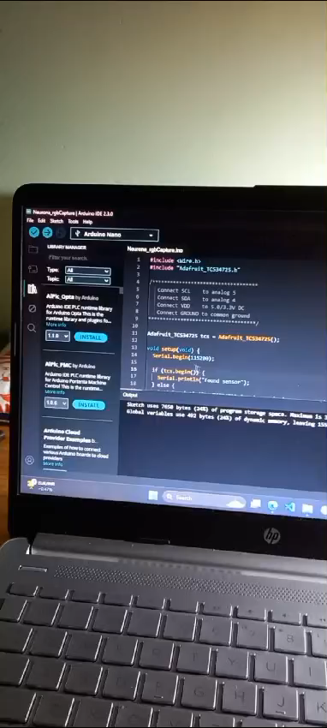
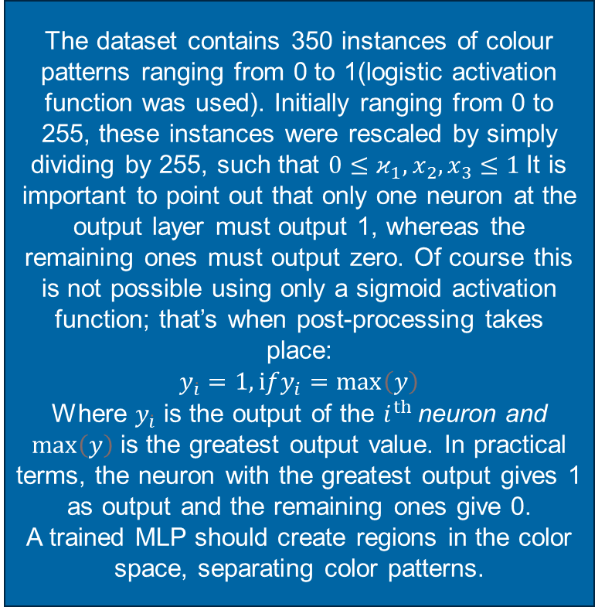
Colour recognition
With the purpose of obtaining generalization with an MLP for a good recognition of RGB patterns, I created a training set (examples of colors with the desired output as shown)
The dataset contains 350 instances of colour patterns ranging from 0 to 1(logistic activation function was used). Initially ranging from 0 to 255, these instances were rescaled by simply dividing by 255, such that $0≤κ_{1},x_{2},x_{3}≤1$It is important to point out that only one neuron at the output layer must output 1, whereas the remaining ones must output zero. Of course this is not possible using only a sigmoid activation function; that’s when post-processing takes place:
$$y_{\dot{i}}=1,ⅈfy_{i}=\max\left(y\right)$$
Where $y_{\dot{i}}$ is the output of the $ⅈ^{th}$ neuron and $\max\left(y\right)$is the greatest output value. In practical terms, the neuron with the greatest output gives 1 as output and the remaining ones give 0.
A trained MLP should create regions in the color space, separating color patterns.

Slide 9
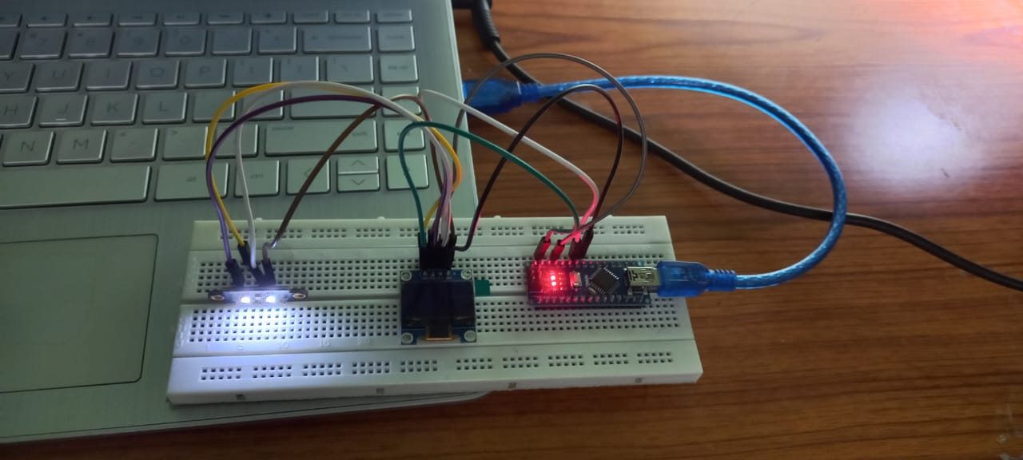
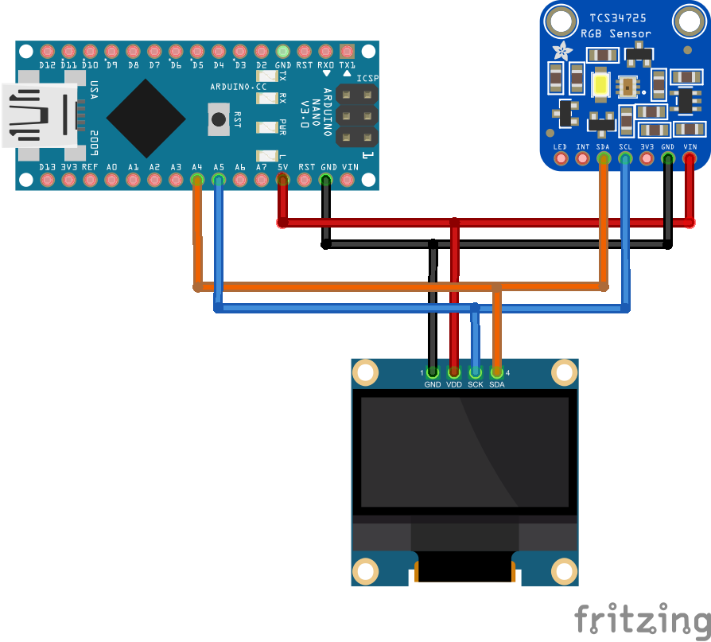
Implementation Electronics circuit

Slide 10
Implementation Electronics circuit

Slide 11
Implementation: Programming
In detection, the collected RGB values - ranging from 0 to 1 - feed to an MLP, performing the actual color recognition. For the MLP running in Arduino, I am using Neurona - a library I wrote to easily use ANNs in arduino, I am using an implementation in C language (The MLP Topology Workbench also does the job), giving the adjusted weights to use with Neurona. I used α = 0.8
Given topologic configuration and the dataset, five trainings were performed (with cross-validation), each one with a random initial state of the synaptic weights:
Training # | Epochs | Accuracy
1 | 1565 | 67%
2 | 2353 | 95%
3 | 3315 | 80%
4 | 4239 | 93%
5 | 680 | 40%

Slide 12
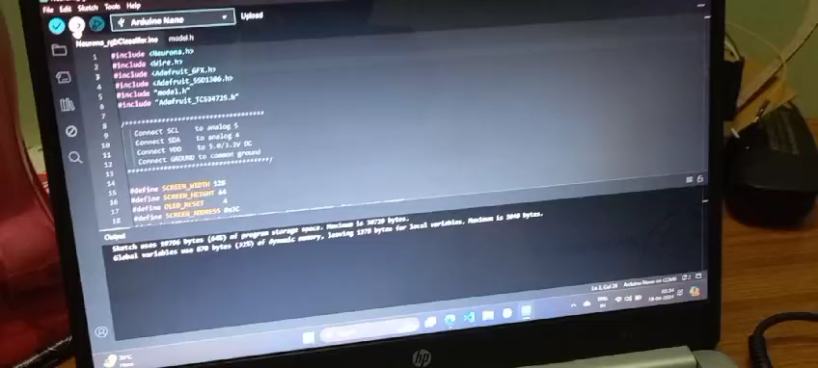

Slide 13
References
Liu, Ye, et al. "Machine learning-based colour vision deficiency correction." Sensors 19.13 (2019): 2924.
2. Colour sensor prototype using artificial neural networks – Caio Benatti Moretti (moretticb.com)
3. Birch, Jennifer, et al. "Assistive technology for people with vision, hearing, and motor impairments." Journal of Special Education Technology 30.2 (2015): 59-70.
4. Shah, Sivananda, et al. "A Survey of RGB Colour Space Models and Conversion Techniques." International Journal of Computer Applications 111.11 (2015): 38-43.

Slide 14
